Slide 1
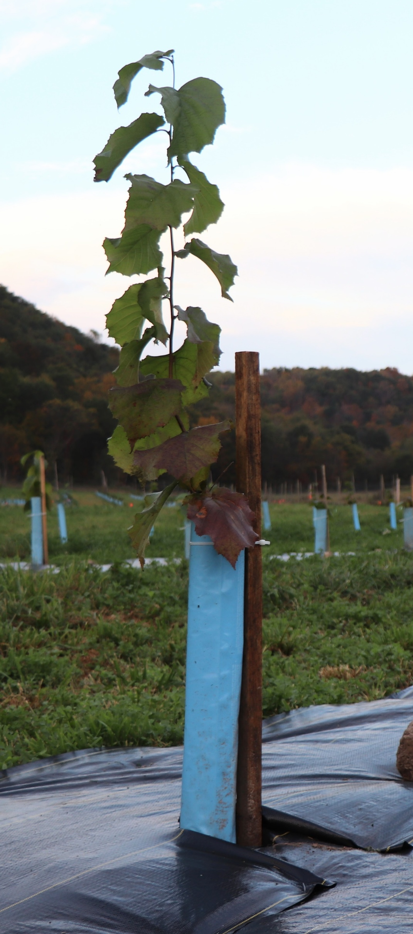




Be a Hazelnut Early Adopter
The opportunity:
The Coon Creek Community Watershed Council is seeking anyone interested in growing hazelnuts in our watershed on a commercial basis.
Benefits for participants
Access to specialized hazelnut hybrids developed for the Upper Midwest at a reduced cost
Access to mentorship from other local growers and hazelnut experts
+ countless economic and ecologic advantages!
The commitment
Order hazelnuts via Midwest Hazelnuts in Spring 2026 or 2027 to plant the following fall
Why now?
The CCCWC received a Sustainable Agriculture Research and Education Grant in partnership with other local hazelnut growers and UW-Extension to:
Support the development of a hazelnut market in our area
Strengthen our local food system
Build community around this local, climate resilient crop
Next steps
Place your order by May 25 to reserve your plants for Fall 2026 .
Request an order form: council@cooncreek
watershed.org
Plants can be picked up from Hauser's Superior View Farm in Bayfield, WI or shipped to you for an additional fee.
We are looking for current and prospective hazelnut growers to participate in our project. No experience with hazelnuts necessary.
Questions about establishing hazelnuts:
jason.fischbach@wisc.edu
Questions about ordering hazelnuts: plants@midwesthazels.com
Questions about cost share eligibility: council@cooncreekwatershed.org

Slide 2
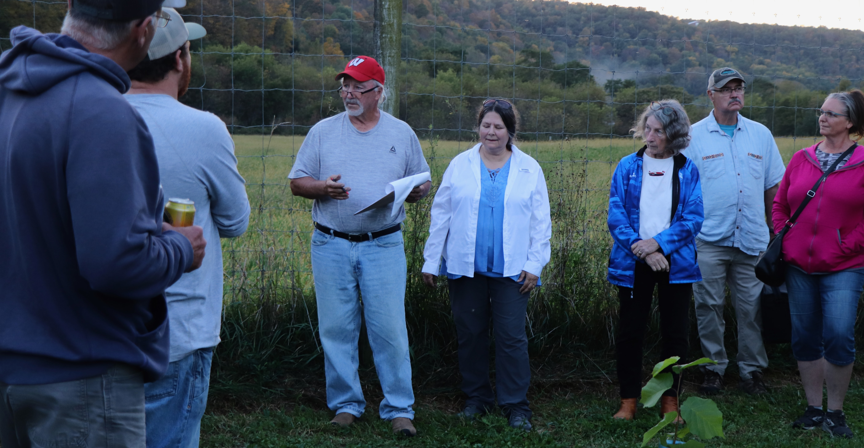
Be a Hazelnut Early Adopter
Next steps
Why plant hazelnuts in the Coon Creek Watershed? We asked the Burke Family, who cultivate hazelnuts in Timber Coulee. Here is what they said:
Place your order by May 25 to reserve your plants for Fall 2026 .
Request an order form: council@cooncreek
watershed.org
Plants can be picked up from Hauser's Superior View Farm in Bayfield, WI or shipped to you for an additional fee.
Hazelnuts are easy to grow. Once planted hazelnut orchards will produce an annual crop for upwards of 10 or more years with minimal maintenance.
Hazelnuts taste great. Hazelnuts oil contains high levels of monounsaturated fatty acids and low levels of saturated fatty acids. In addition to oil, the pressed meal is gluten free, contains high levels of proteins, carbohydrates, fiber and minerals.
Hazelnuts are in demand but supply is limited. Global production is expected to double in the next decade.
Hazelnuts are great for the environment. They build soil, sequester carbon, provide wildlife habitat.
Hazelnuts are a new agricultural business opportunity, and they can bring ecologic and economic diversity to your farm.
About Midwest Hazelnuts, LLC: Hazelnuts used to be widely distributed in the Midwest, especially in the oak savanna biome. Midwest Hazelnut’s goal is to restore them to their grandeur by creating a Midwest hazelnut industry that enriches the land, farmers, wildlife, and rural communities. They are protecting soil and water with agriculture, not from it.
Charley and Mary Jo Burke lead neighbors on a tour of their hazelnut orchard during the Oct. 2025 CCCWC meeting

